Slide 1
GameCo Sales Data Analysis
GameCo is a company that operates in the Videogames release and sales Worldwide since the year 1980.
The Data from which this Analysis is been conducted is been collected from GameCo and different regional partners from year 1980 to 2020.
We are conducting an analysis to give insights for the coming year 2017 and beyond, in order to properly address Marketing Budget for every Regional Market.
GameCo’s current understanding about sales for the various geographic regions: Executives are assuming that Sales have stayed the same over time.

Slide 2
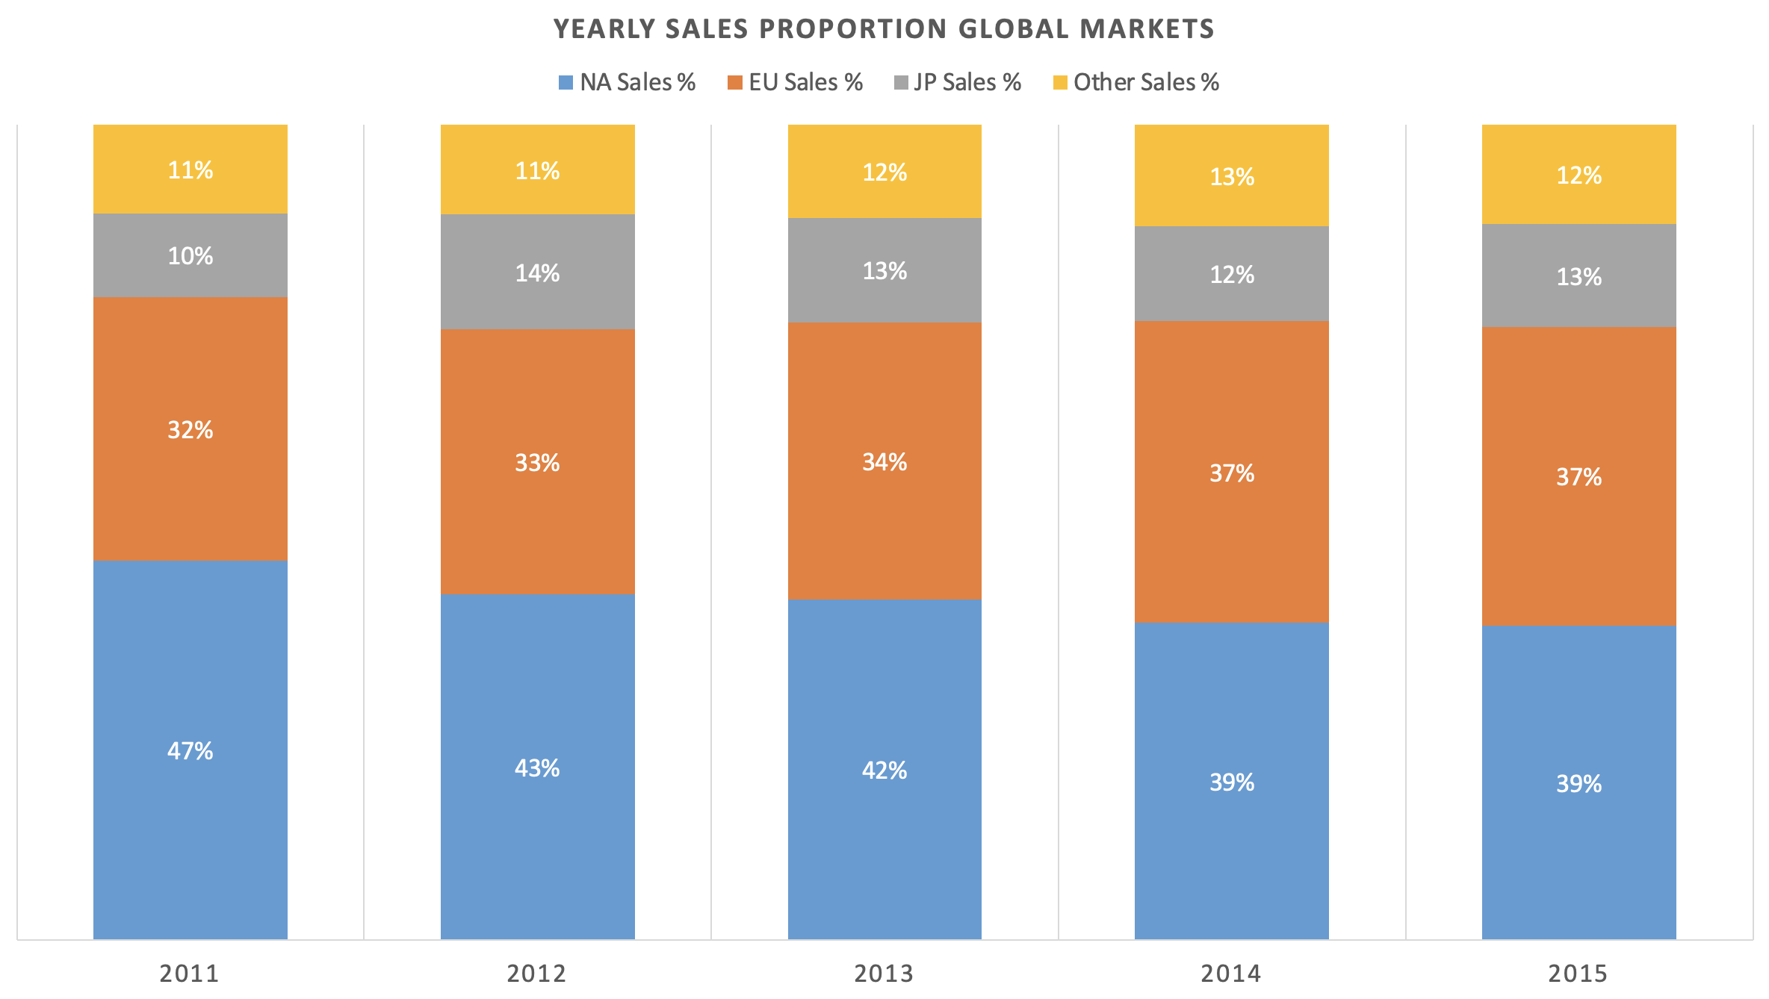
Year 2011-2015 Regional Markets Sales Proportion
The Chart Reflects Data on GameCo Yearly Regional Sales from 2011 to 2015
The data suggest that in fact there is been a significant change in the proportions of Regional Market Sales.
While Secondary Markets have slightly increased (Japan and Smaller Markets);
North American Sales have decreased compared to European Market.
These two markets are now levelled up at around 40% of Global Sales.

Slide 3
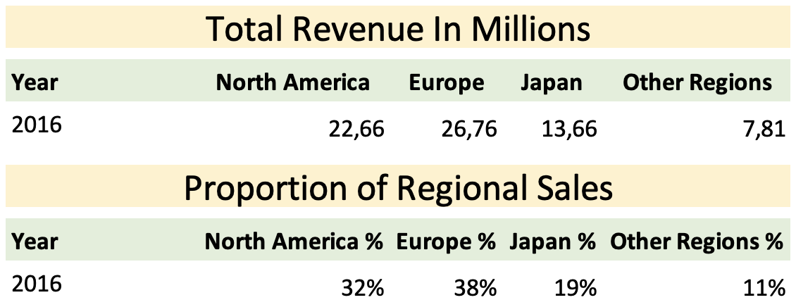
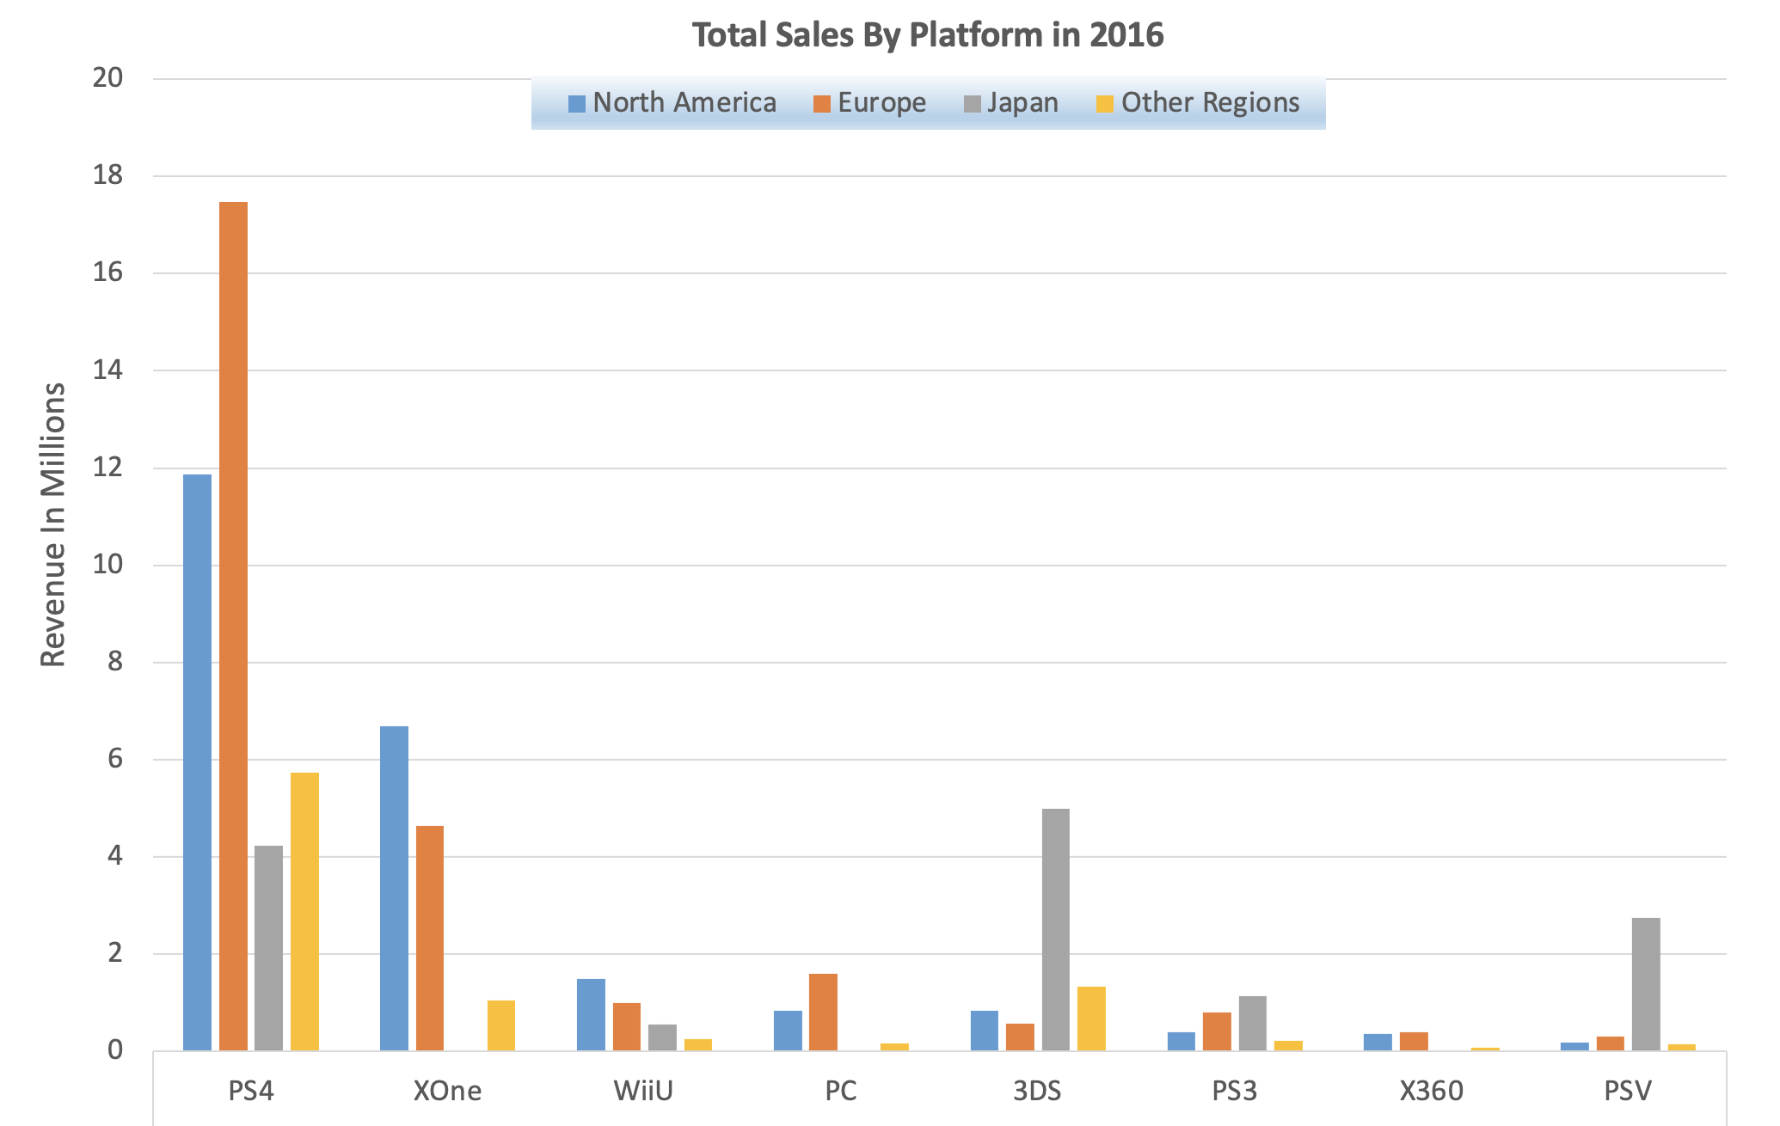
- Year 2016 Sales Insights -
European Market had the largest sales figures,
followed by North America
PS4 is the platform where most titles were sold, followed by Xone
3DS and PSV are the plaftorms with most sales in the Japanese Market

Slide 4
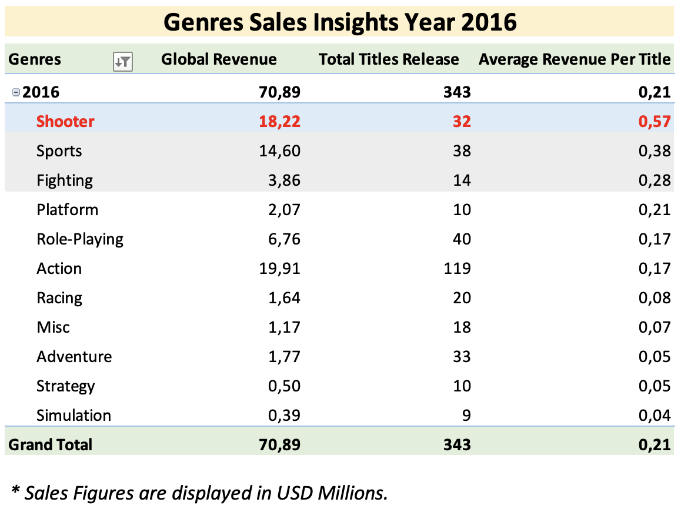
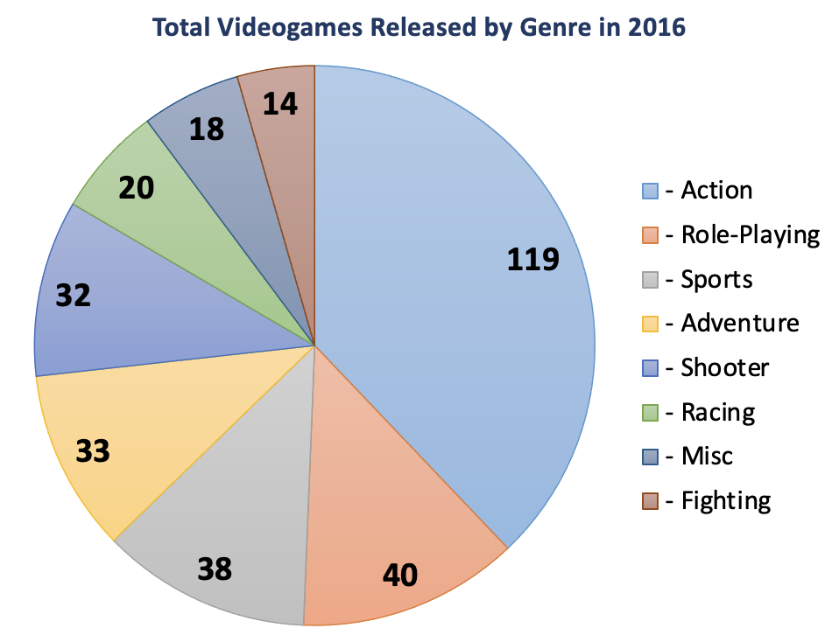
- Genres In Depth Global Market Analysis -
Action Videogames were considerably the most released during the year
It is important to note that when considering the average revenue by genre, Action videogames had a revenue of 0.17 millions, while Shooter videgames had an average revenue of 0.57, with only 32 titles released.
We can then assume that Shooter Videogames make more revenue compared to Action Genre.

Slide 5
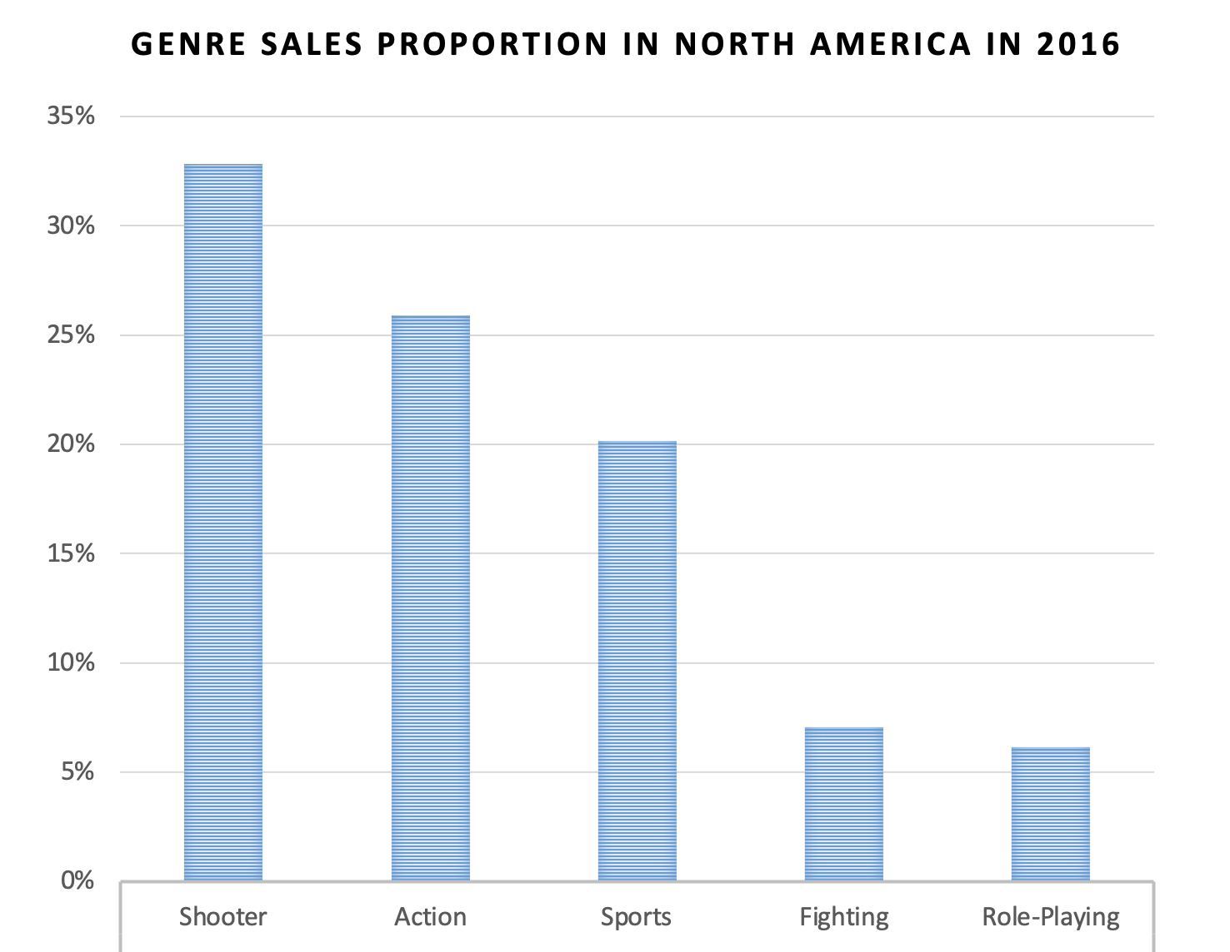
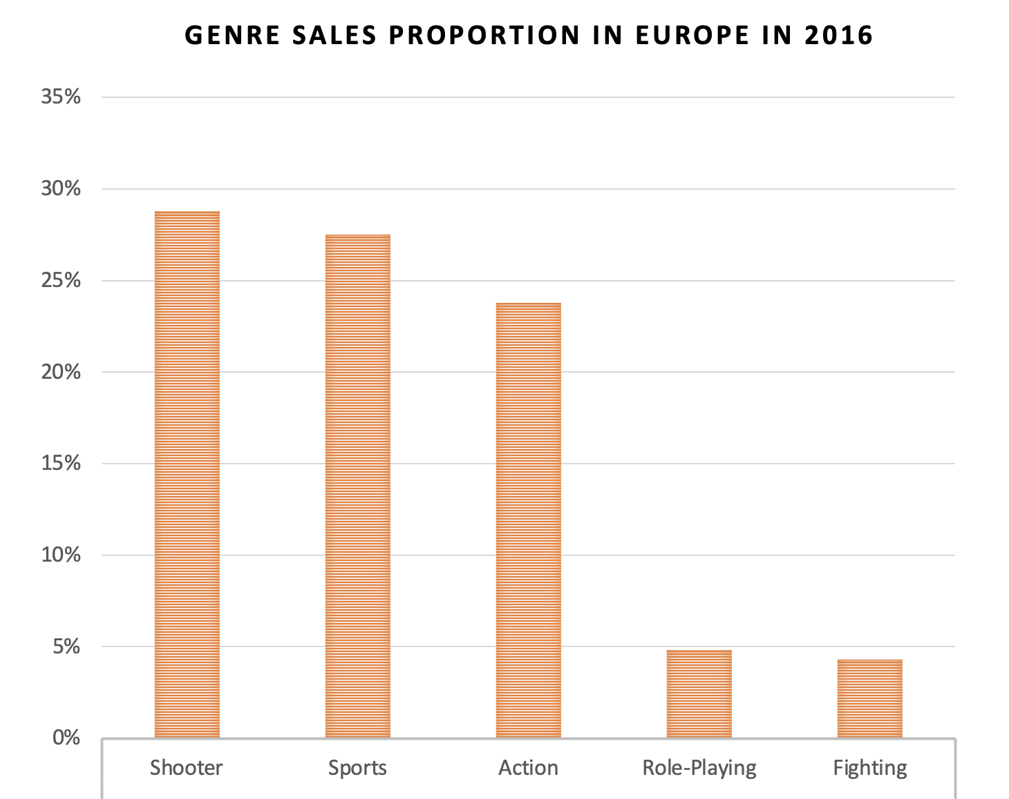
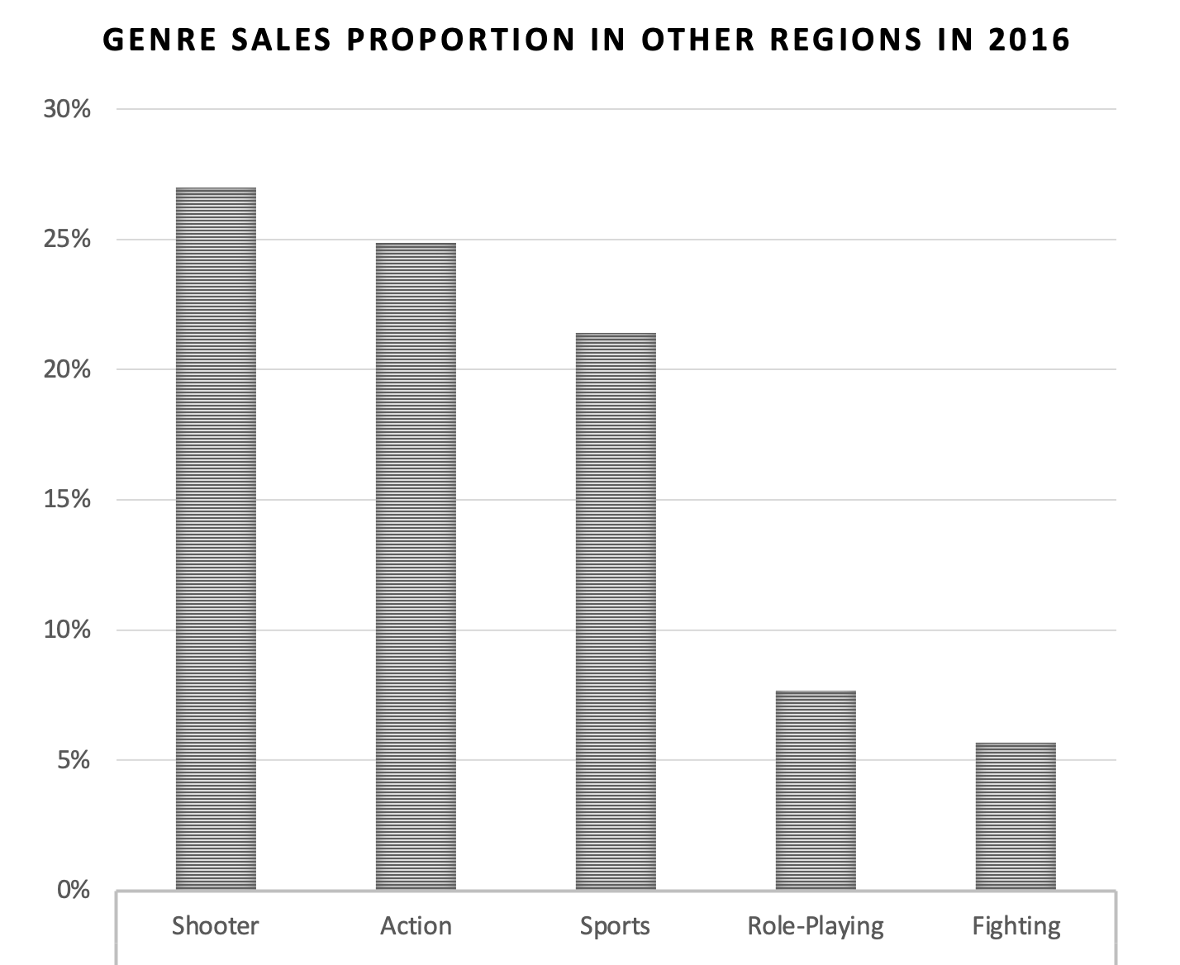
- Regional Markets Genres Sales Proportions -
North America, Europe and Smaller Markets seems to have the same trend in Genre popularity
Shooter is the Genre with most Sales in these Markets, with a percentage of around 30%
Action and Sports are the following two Genres with most Sales.
These three genres combined account for a percentage in Sales around 65-75%

Slide 6
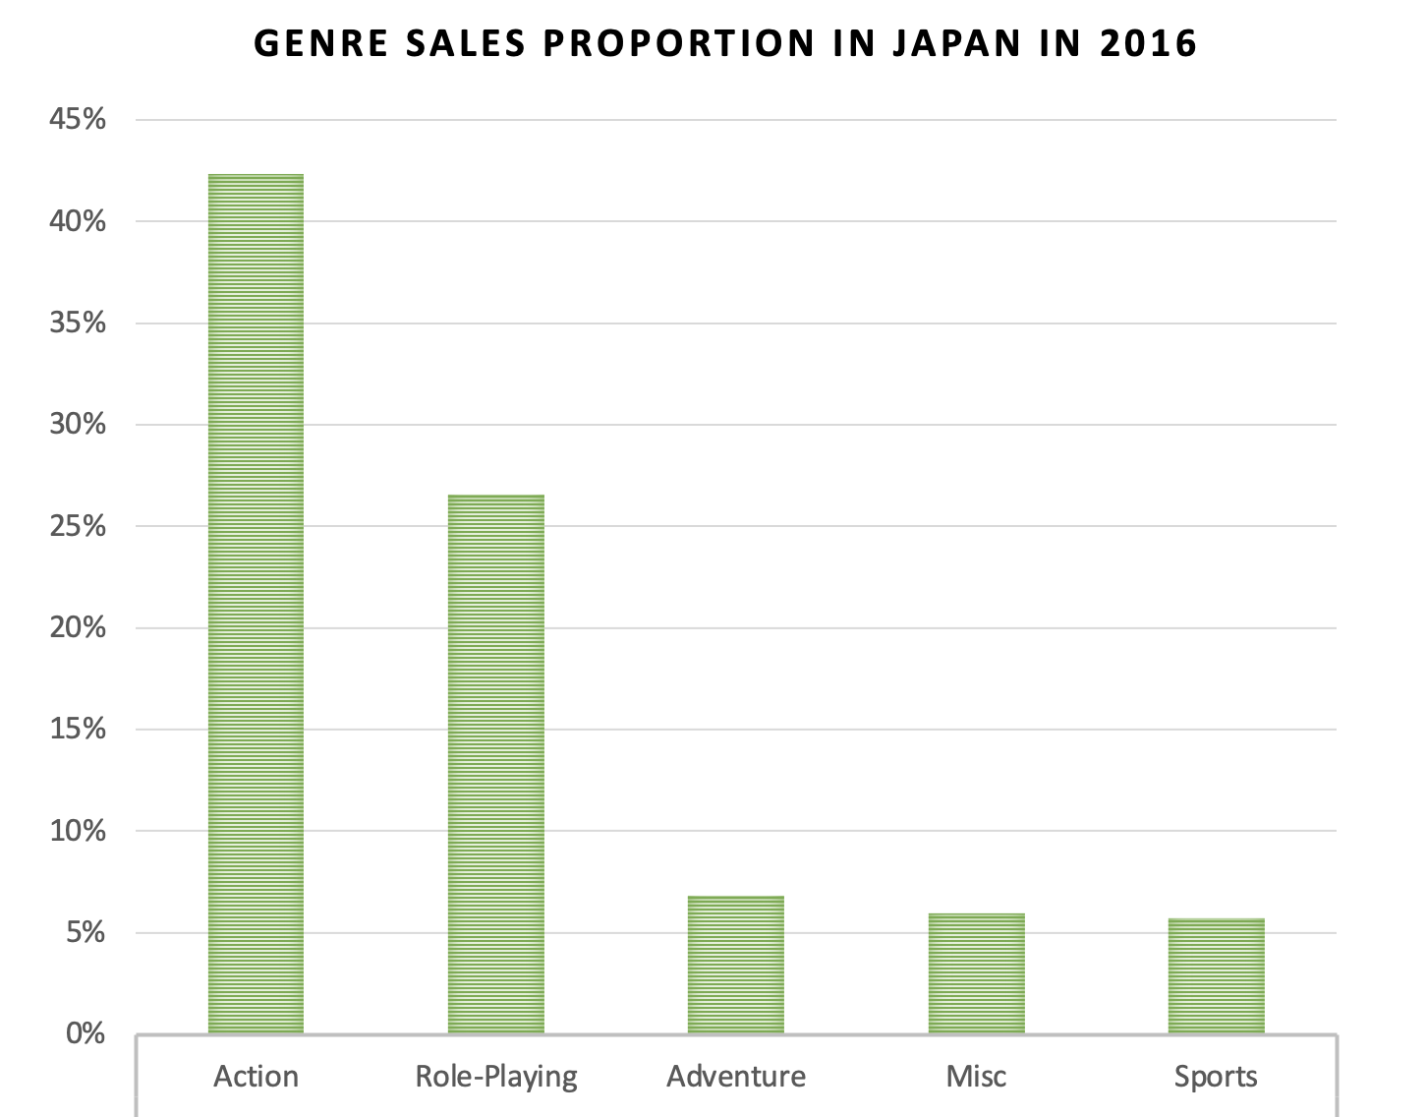
- Regional Markets Genres Sales Proportions -
Japanese Market shows very different Genres Sales Trends compared to every other Market Worldwide
Action is by far the most popular Genre with 42% Sales
Role-Playing is the following most popular Genre with 26% Sales

Slide 7
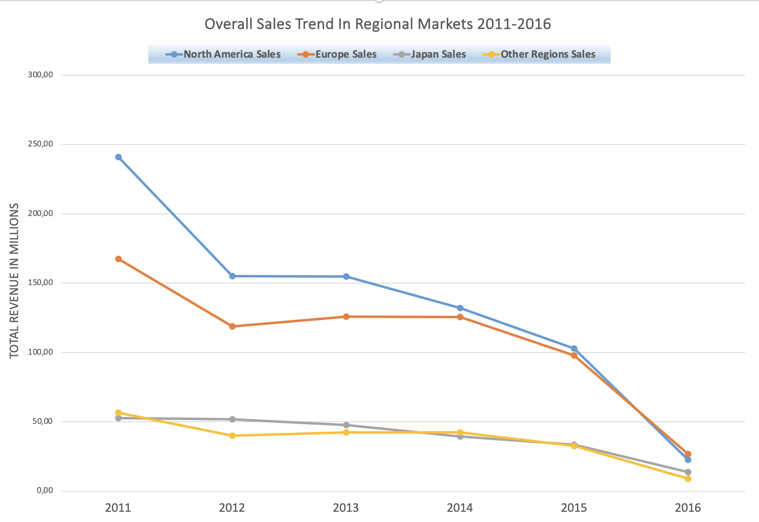
General Updated Videogames Sales Trend
Is very important to notice a steep decline in overall Sales trend over the last five years.
From the year 2011 onwards, the Sales have decreased with huge Sales loss especially in the two major Markets, North America and Europe.
This surprising insight should require further analysis, so we can better understand the reasons behind this important decline.

Slide 8
- Final Conclusions -
As outlined in Slide 2, the Regional Market Proportions have changed during the years, with the year 2016 showing the European Market having surpassed North America in Sales Figures.
Despite this findings both the American and European Market have the largest sales worldwide, so an equal marketing budget I think can be considered between the two markets.
Is also important to notice an overall steep decline in sales in every markets in the last few years (as shown in Slide 7).
Another important finding is that shooter games have an higher average sales revenue compared to other genres. (Slide 4)
Playstation4 is by far the platform with most sales worldwide. (Slide 3)
Shooter, Action and Sports are the genres with the highest sales in every markets; apart from the Japanese Market where Action and Role-Playing makes the most revenue (Slide 4)

